Slide 1

Swapping Variables

Slide 2
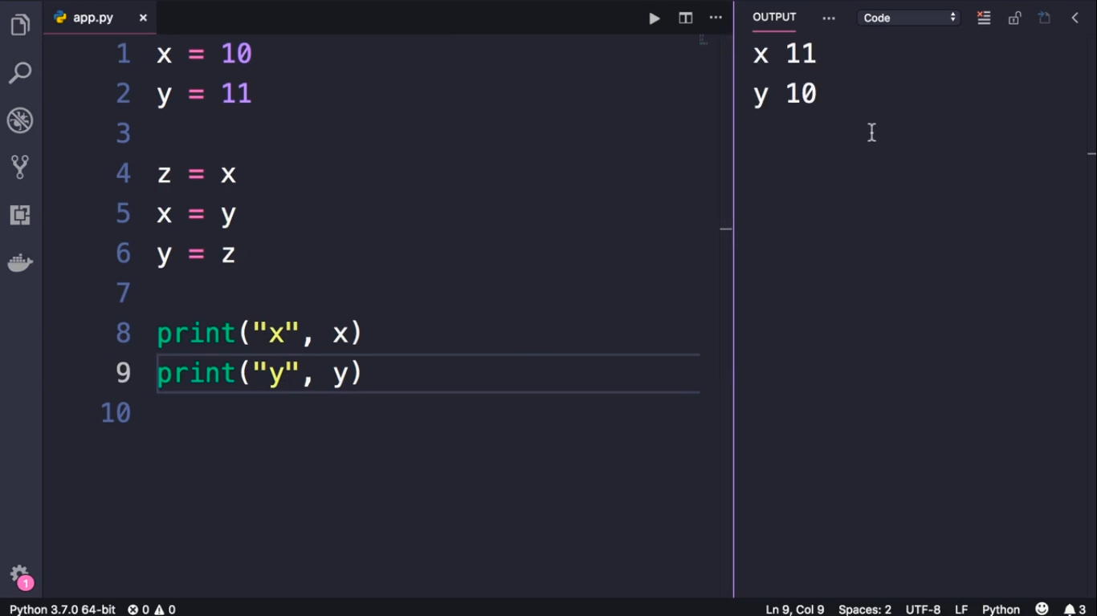

Slide 3
